Slide 1

DHANALAKSHMI SRINIVASAN COLLEGE OF ENGINEERING (AUTONOMOUS) COIMBATORE - 641 105
Department of Electrical and Electronics Engineering
WIRELESS VEHICLE CHARGING USING INDUCTIVE POWER TRANSFER
Guide Team Members
Ms Jerrin Aman Ali Khan(7219211005)
Dhanalakshmi Srinivasan college Kamalavasan(721921105024)
of Engineering Rakesh Kumar(721921105036)
Coimbatore Veeralinga(721921105055)

Slide 2
INTRODUCTION
Wireless power transfer (WPT). Wireless power transmission wireless energy transmission or electromagnetic power transfer is the transmission of electrical energy without wires. Wireless power transmission technologies use time varying electric. Magnetic Or electromagnetic fields. Wireless transmission is useful to power electrical devices where interconnecting wires are inconvenient. Hazardous or are not possible.
Wireless power techniques mainly fall into two categories. Non radiative and radiative. In near field or non-radiative techniques power is transferred by magnetic fields using inductive coupling between coils of wire or by electric fields using capacitive coupling between metal electrodes. Inductive coupling is the most widely used wireless technology.

Slide 3
OBJECTIVE
To design and implemente converter for EV with inductive power transfer
Wireless power transfer
Double-sided compensation
Reduce receiver coil size

Slide 4
CONVENTIONAL CIRCUIT
The conventional circuit consists of input DC supply full bridge rectifier then the transmitting coil and receiving coil.

Slide 5
PROPOSED METHOD
The transmitter side is comprised of a high frequency inverter an EC compensation network and a transmitter coil.
The compensation network cf .f and the coil Li-constitutes a compensation resonant circuit.
The inverter with full bridge structure is composed of four power MOSFETS (SIS4).
The receiver side consists of a symmetrical LC compensation resonant circuit and a rectifier.
For the purpose of battery pack charging an IC filter network is placed on the receiver side.

Slide 6
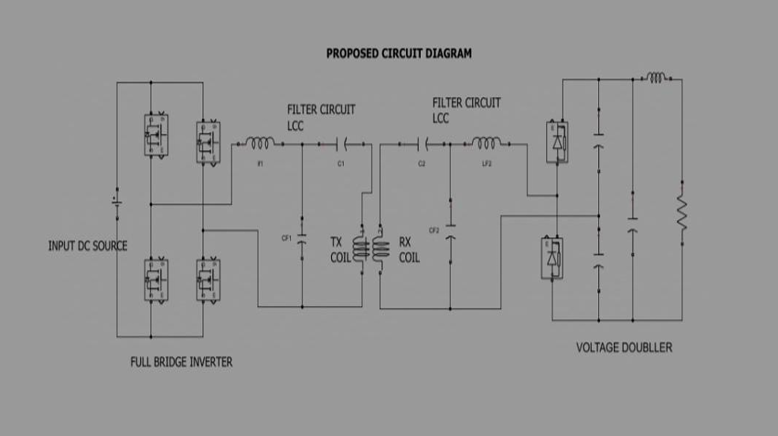

Slide 7
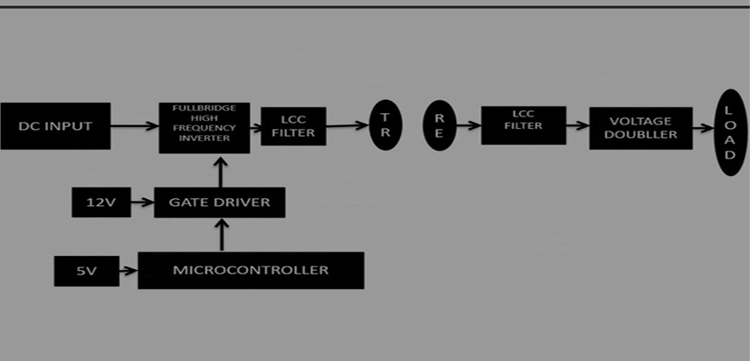

Slide 8
APPLICATION
Cell phones.
Laptops.
Tablets.
Smart watches
Aerial Vehicles and Solar Power Satellite

Slide 9
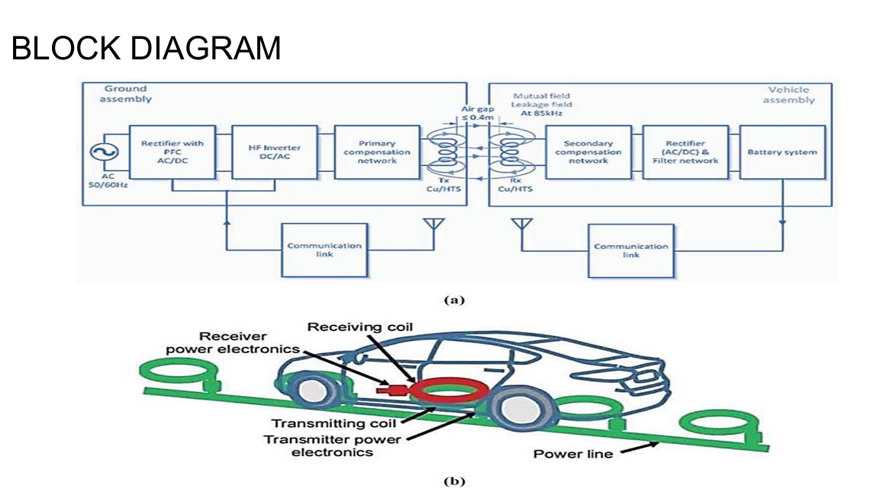

Slide 10
ADVANTAGES
● Reduced energy loss
● Sustainable energy source
● Optimizing charging
● Improve public heat

Slide 11
DISADVANTAGES
● Electromagnetic interference
● Heat generation
● High losses
● Limited charging speed

